Slide 1
6조 Project Presentation
정의권 장재현 채민기

Slide 2
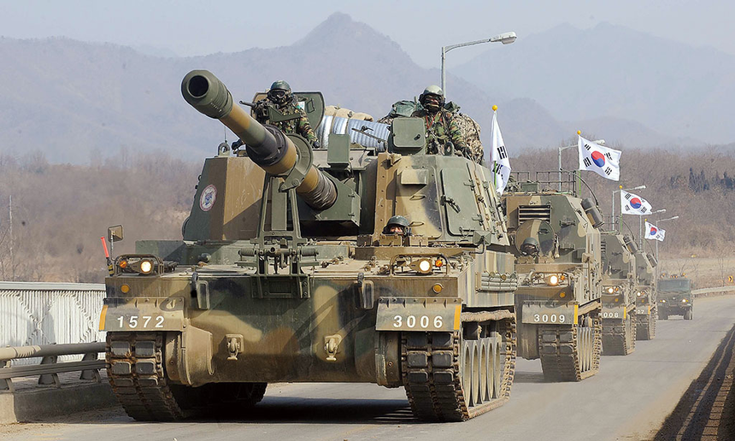
킹갓 제너럴 엠페러 마제스티
골져스 프레셔스 뷰티풀
하이 클래스 엘레강스 럭셔리
클래식 지니어스 원더풀 러블리
월드 탑 클래스 RC - TANK

Slide 3
Introduce to functions
Question & Answer
Account for concept
Demonstrate work

Slide 4
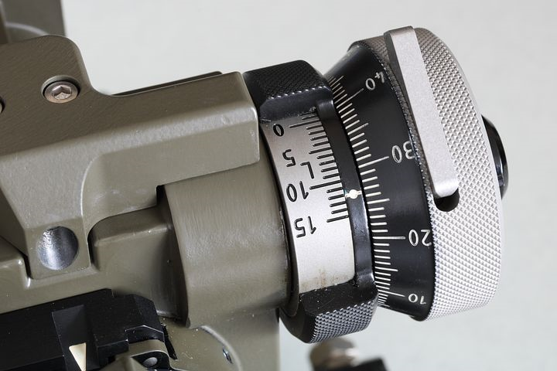
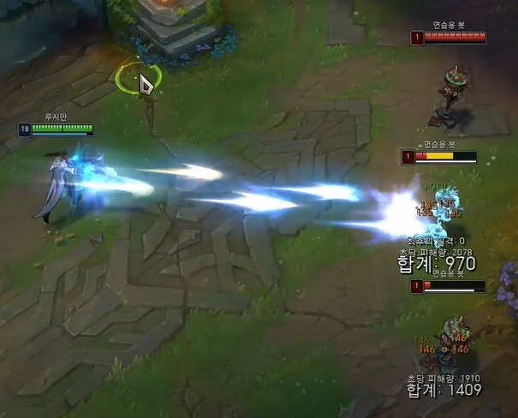
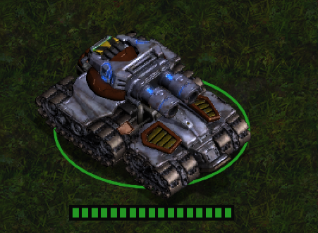
Concept
RC - CAR ⇢ K - 9 ?
Embedded
Defense Industry
Entertainment
Various functions

Slide 5
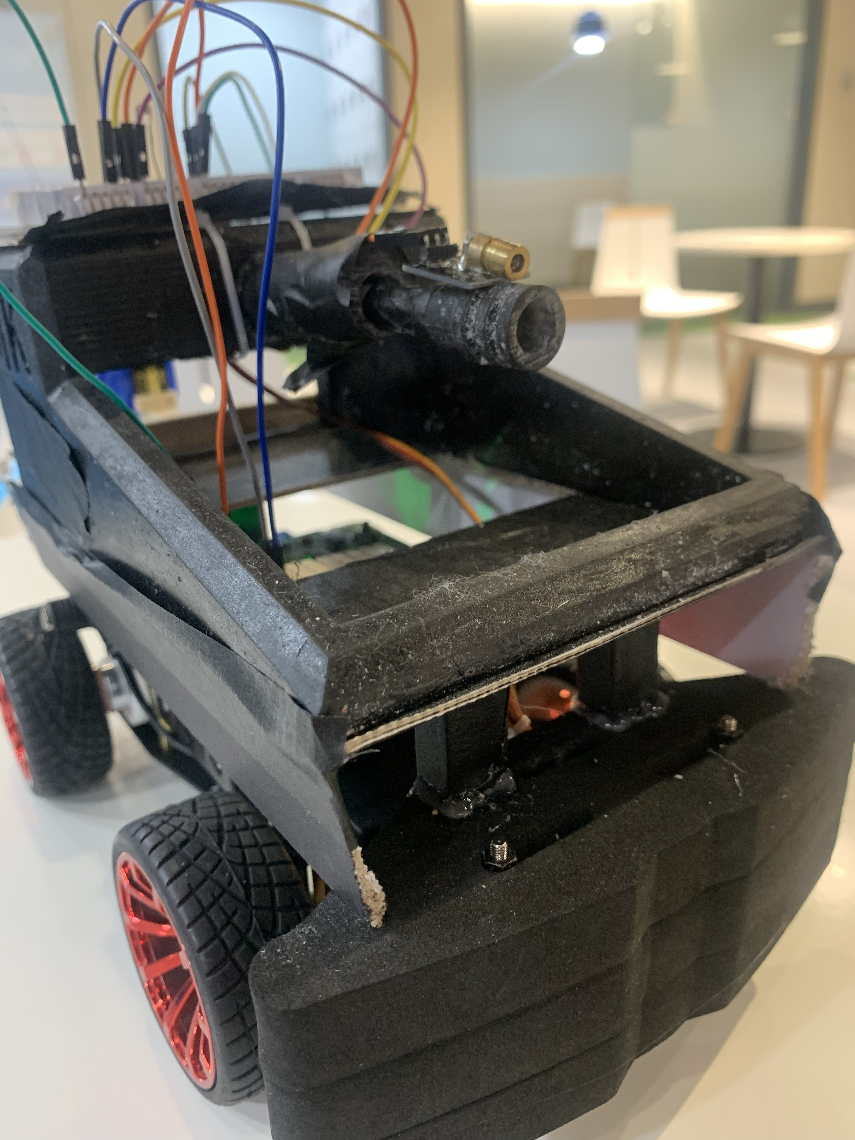
Aimming Lazer :
Push ‘A’, lazer on
After shoot, lazer off
Gun Barrel :
3D - model
Push ‘S’, cannon shooting

Slide 6
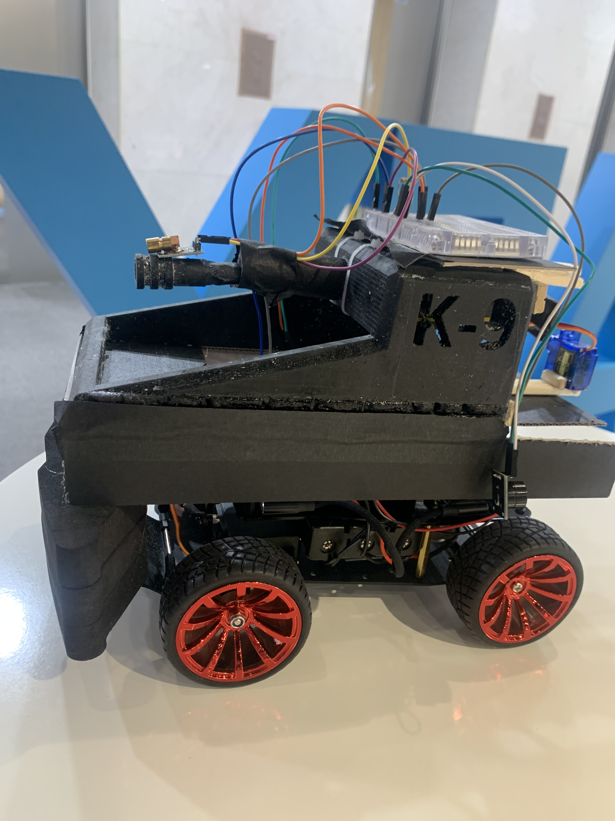
Trigger Motor :
Push ‘S’, servo motor turn
When motor turns, trigger operate
Warning Buzzer :
Push ‘S’, buzzer playing
buzzer play before cannon shoot

Slide 7
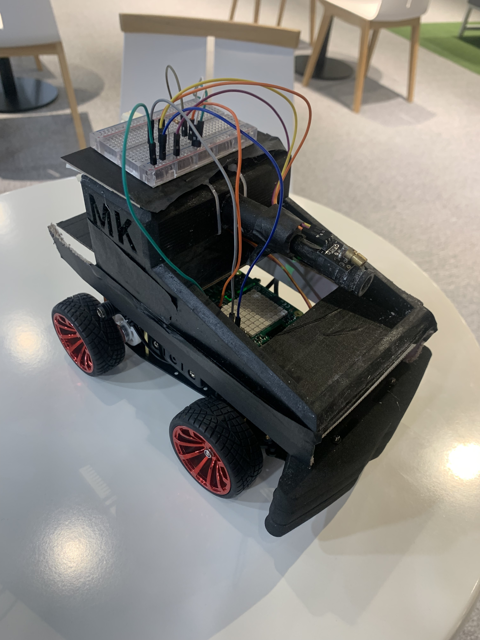
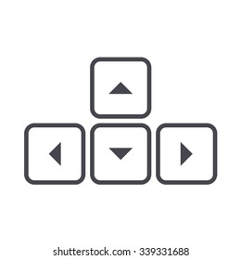
How to Move :
By arrow button
Use keyboard interrupt / thread
Effect for :
Operate immediately
Perform multi command

Slide 8
Demonstrate the work

Slide 9
Ask a Question ☺

